Slide 1

Stage 4 Iron Triangle Course Designer: Arthur Wang
Iron Triangle is a 24 round, 120 point, COMSTOCK Long course. There are 12 USPSA targets. The best 2 hits per target will score.
The start position is standing with feet touching the start stick, wrists above shoulders. Handgun is loaded and holstered. PCC start position is standing with feet touching the start stick, stock on belt. PCC is held above shoulder height, safety on.
On the audible start signal, engage all targets from within the shooting area.

Slide 2
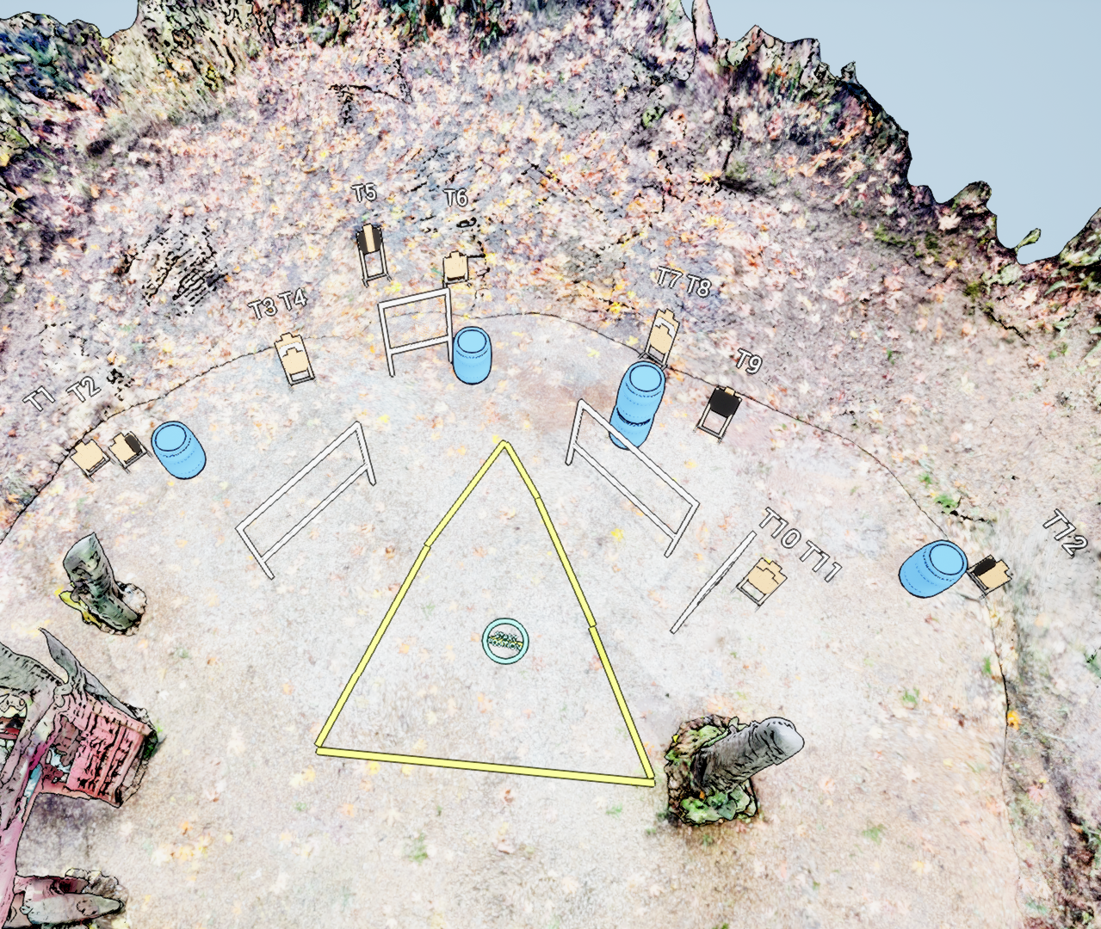
 | Stage 4 Iron Triangle Course Designer: Arthur Wang

